Slide 1

Micro credit defaulter
Author: Prinjal Dave
Department: Data Science
Date: 3 Dec 2020

Slide 2
Business Problem
Being a telecommunication company the client requires to detect the defaulters who are taking disadvantage of a service which helps low-income families by giving a micro credit loan for providing seamless services to their customers.
We are expected to create a model that identifies whether a customer will be a defaulter or not with given set of parameters.

Slide 3
Conceptual background
To dive deep into the domain and before creating a well performing model we need to understand some features from the pool of features.
We need to analyze the features and their value authenticity.
We can also check whether the pcircle (service providing company) has any impact on the label or not
Also, month can be extracted from pdate feature and we can check the analytics and relation of it with label
Thereby, before creating a model or preprocessing the data we will take an insight on the domain by checking the feature list
The below link can be referred to understand what companies were doing to solve this problem before using Data Analytics and Machine Learning model:
https://www.smartcampaign.org/storage/documents/what_happens_to_microfinance_clients_who_default_eng.pdf

Slide 4
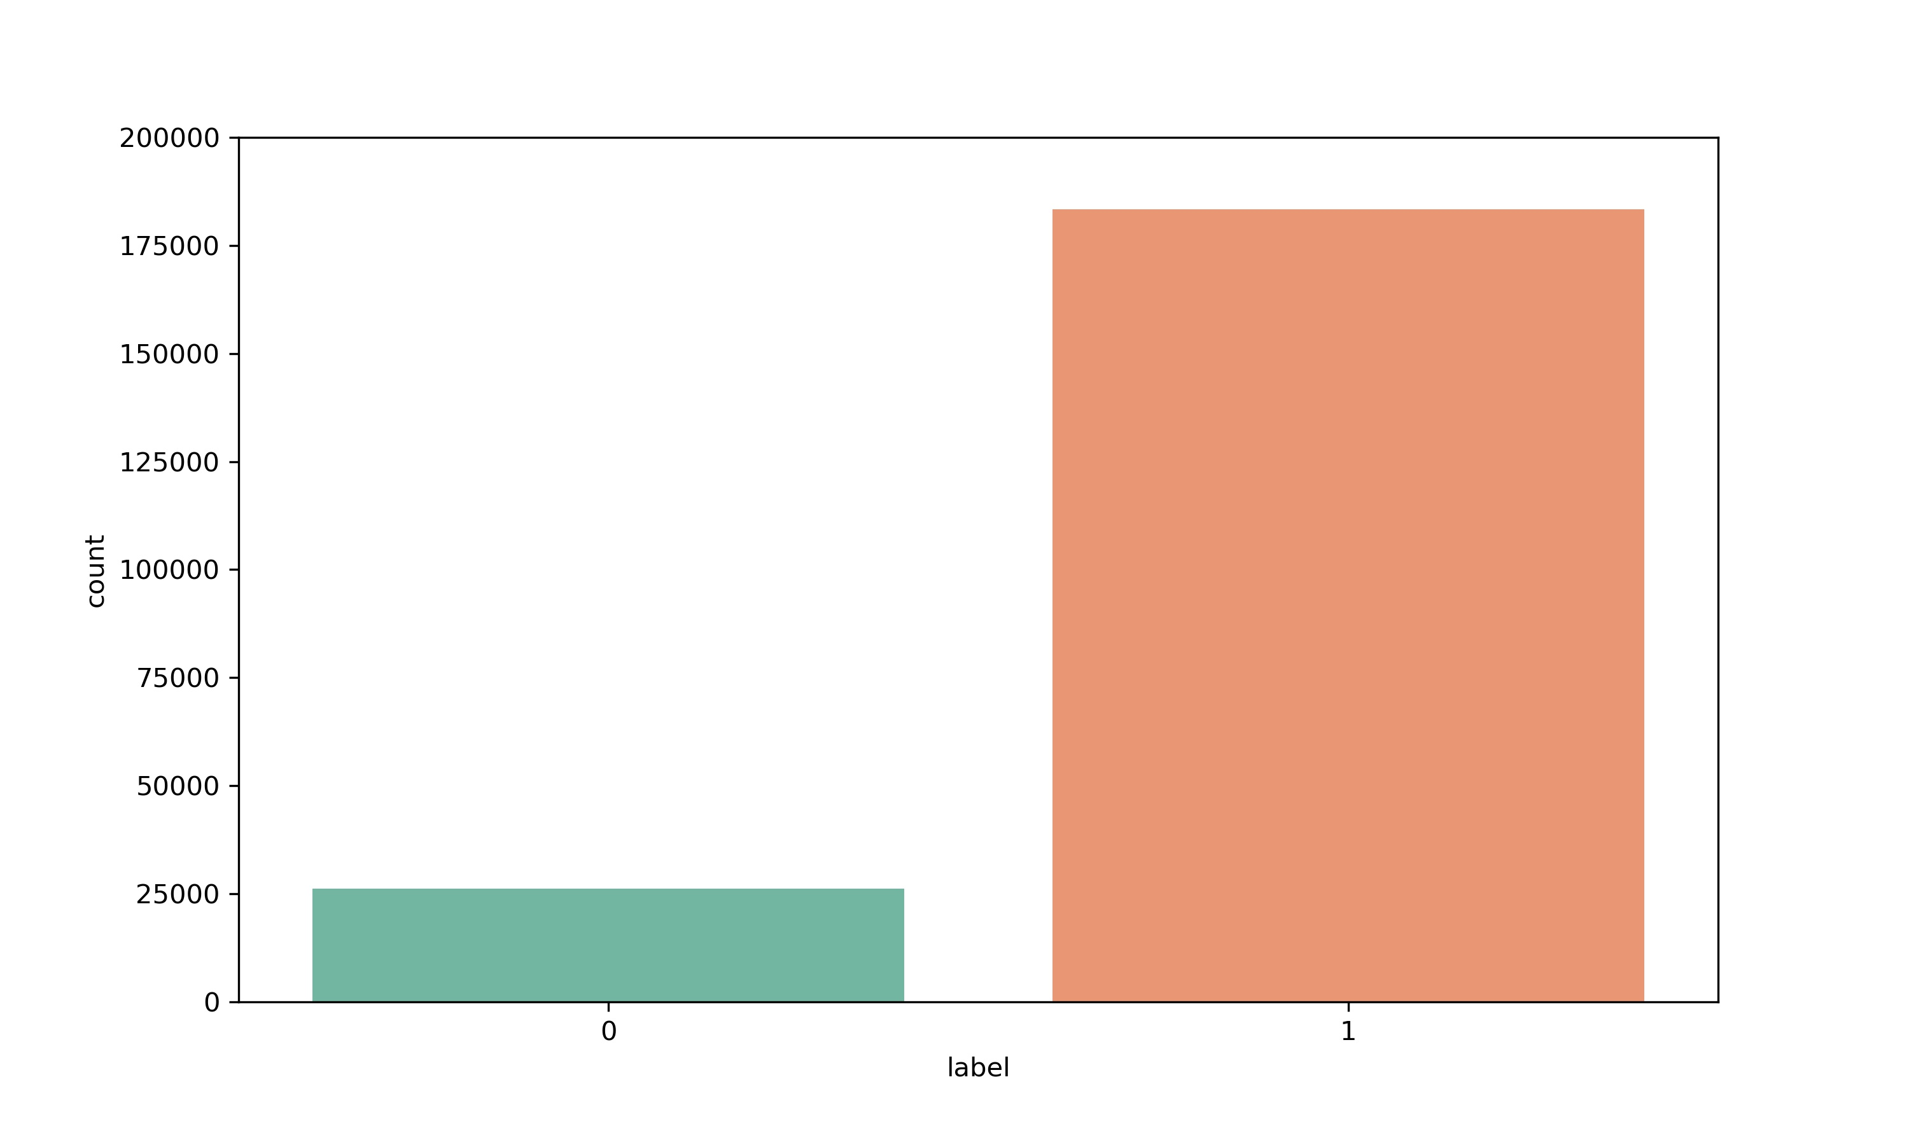
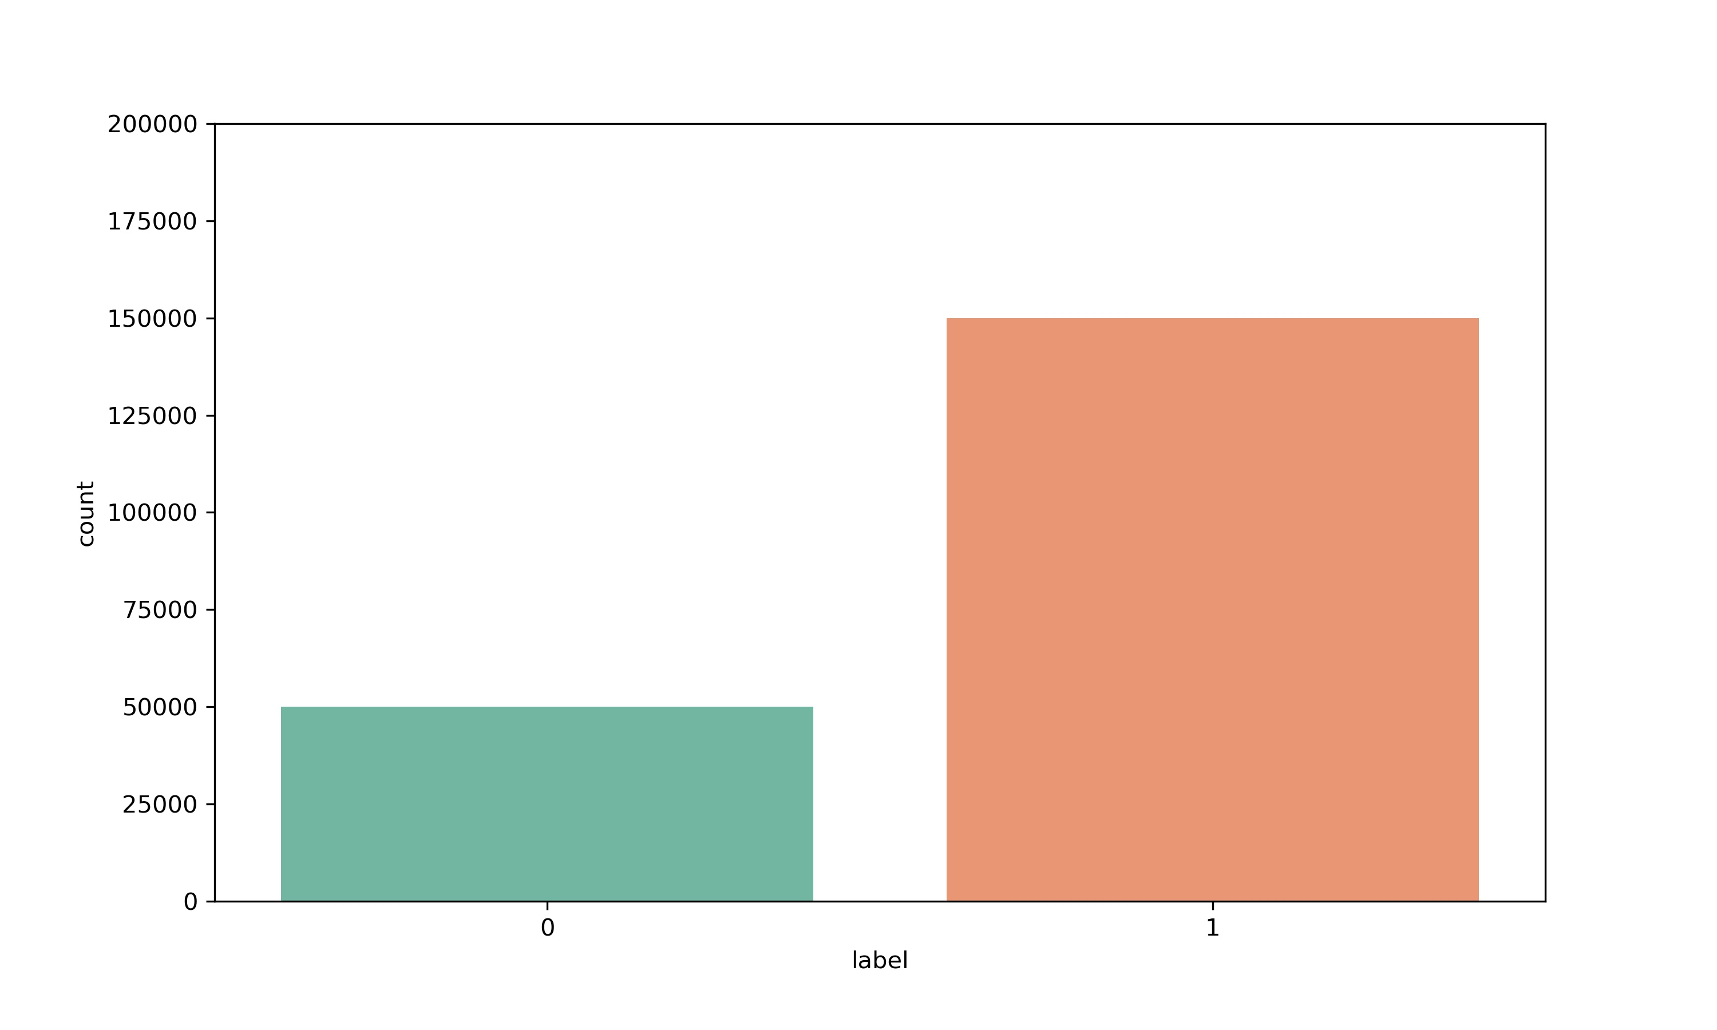
Analytical modeling
After getting an insight of the data out of the system we would have to check whether the data is statistically significant or not.
While checking statistics of data we found that the target column is highly imbalanced and hence our foremost step was to resample the data and balance the target column.
Before Sampling
After Sampling

Slide 5
Data input output relationship
Before preprocessing the data we needed to check the correlation of feature columns with the target column.
Also, we need to check the multicollinearity and discard some features for training our model at low resource cost.
In the next slide we have can observe the images that show the correlation of features with target column and correlation heatmap.

Slide 6
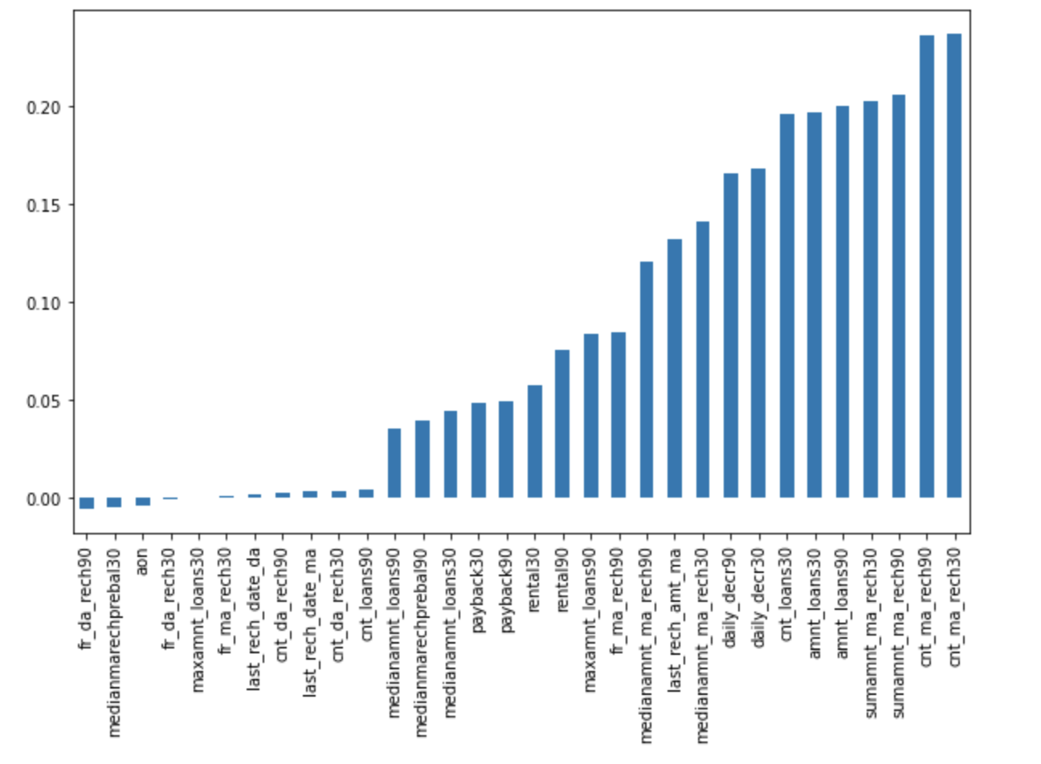
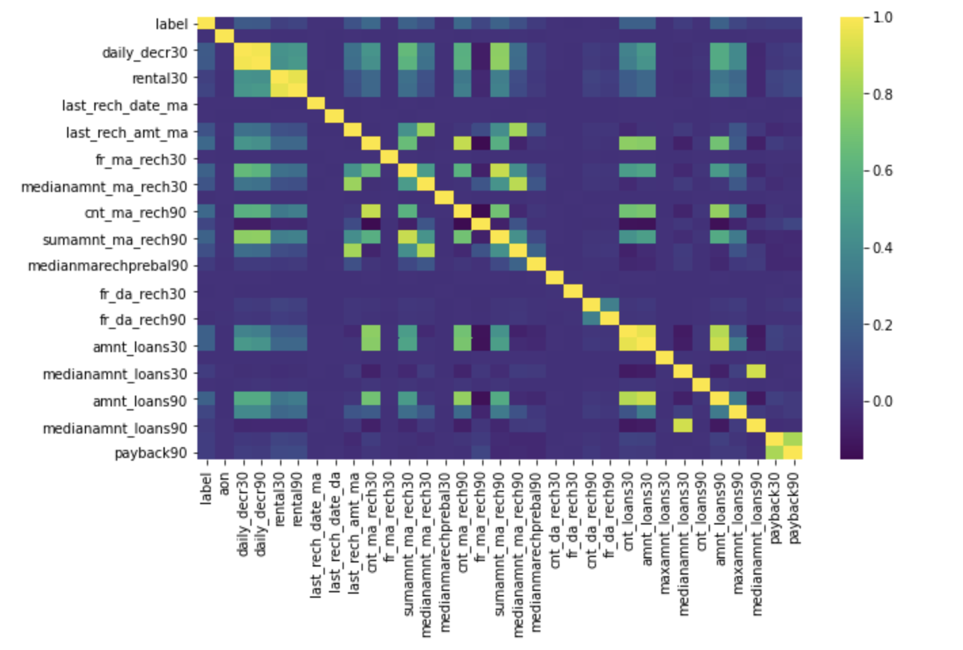
Images showing correlation with label and correlation with heatmap from left to right
Correlation with Label
Correlation Heatmap

Slide 7
Data preprocessing
After balancing the dataset and getting an insight on the correlation between in the data we checked the anomalies in the data found that if we compute the data statistically and discard the anomalies then it will a major loss of 10-12% of data which can affect the data collection cost.
Also, the anomalies were observed by diving into the domain and we were convinced for keeping the data without removing anomalies as there might be difference in one person spending average data in 30 days to other person spending average data in 30 days.
Hence, our next step was to make the data as normalized as possible by removing the skewness.
Thereafter we scaled the data make all the columns of equal scale which will help the machine to learn the data without any bias upon absolute values.

Slide 8
Model development and evaluation
We computed different models on this data and created a bar plot which can be referred in next slide to compare the evaluation side-by-side.
As expected Random Forest outperformed other models as it has capability of managing anomalies if any.
The next slide will also show a plot of Receiver Output Characteristic graph.

Slide 9
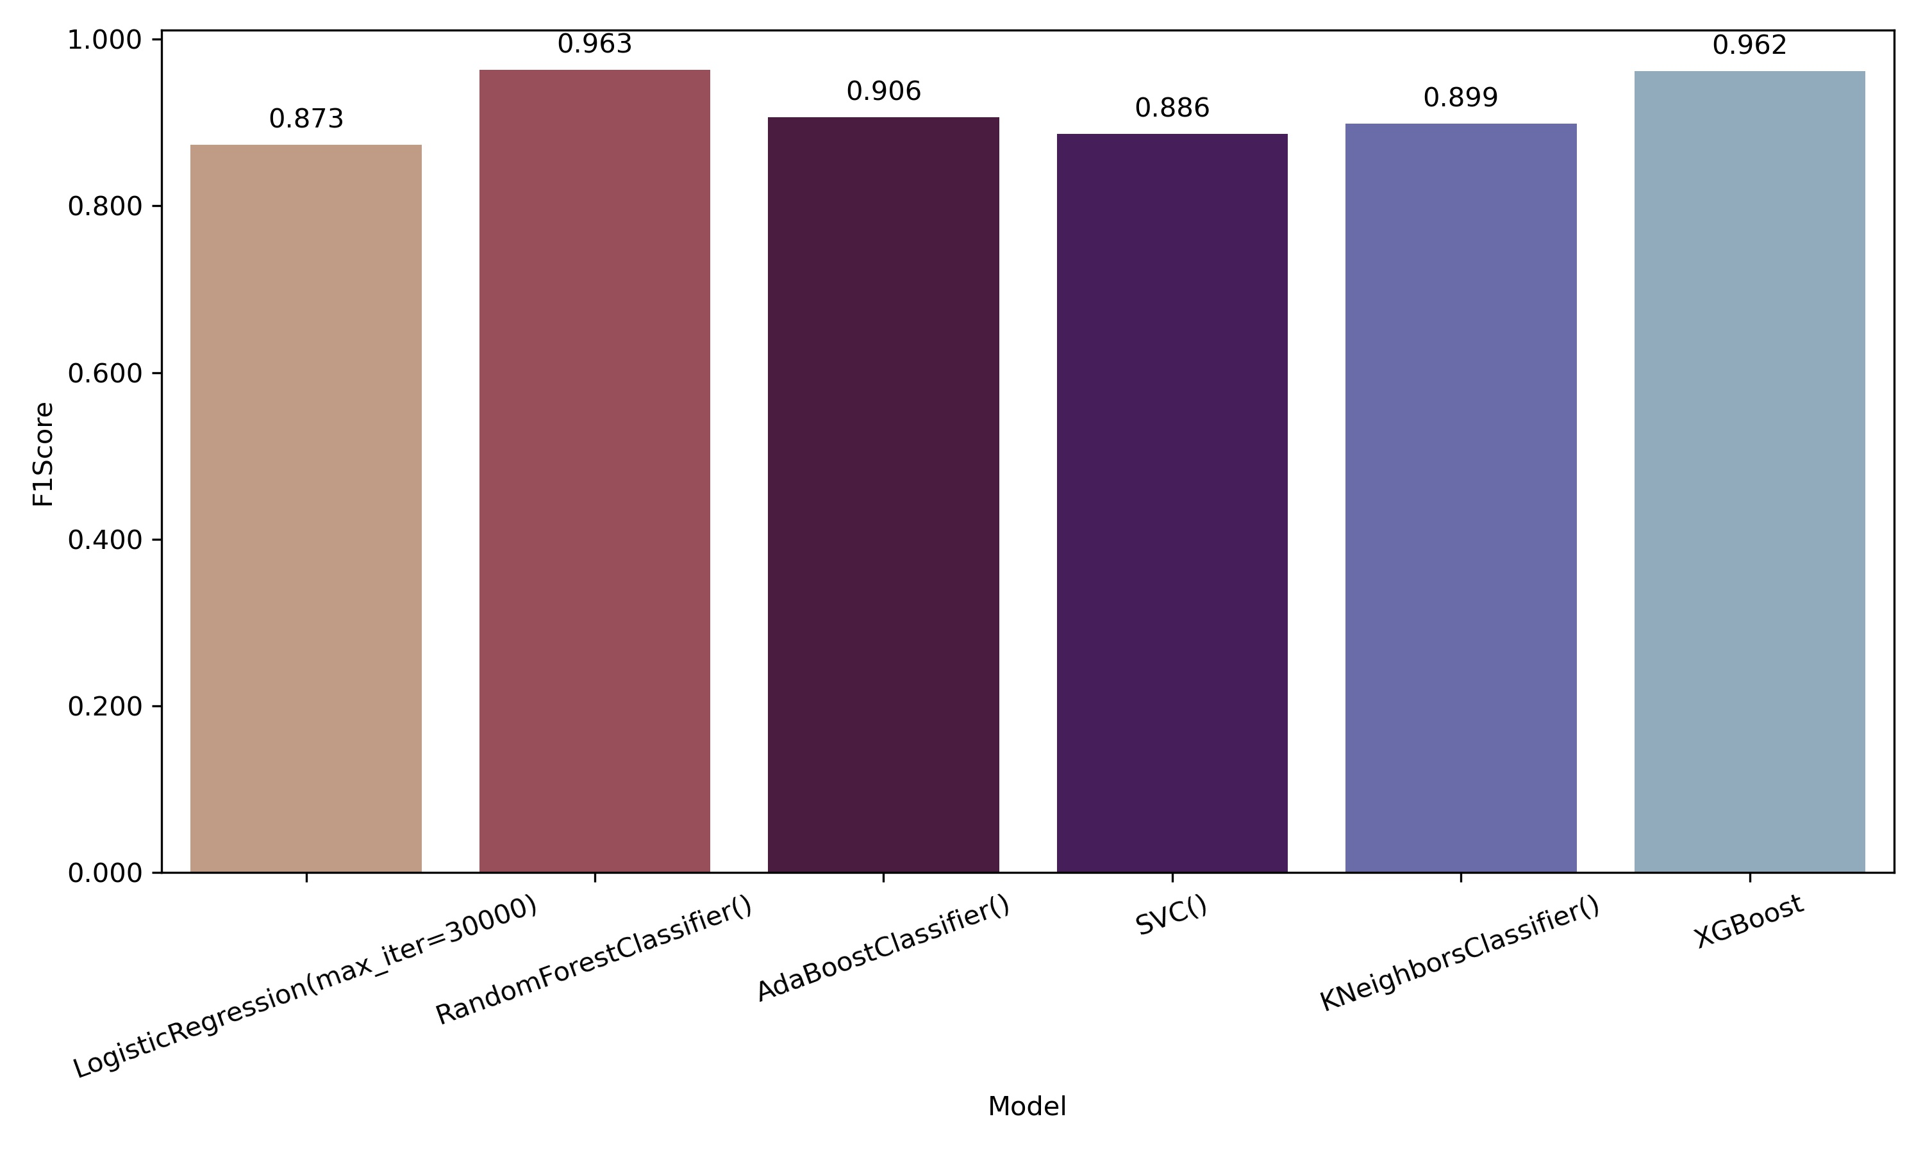
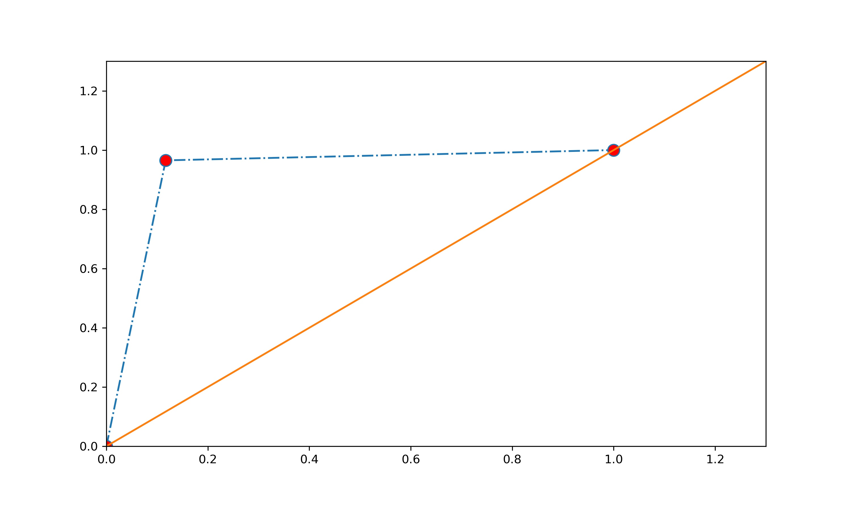
Images of Model performance and ROC Curve from left to right
Model Performance
ROC Curve for Random Forest

Slide 10
Scope of future work
With the help of Random Forest model we can not only solve the prediction of the label but can also dive into inference of the features which will help us understand which feature has high impact on the target column and we can directly attenuate the defaulters.
In current model we can depict the feature importance of each column but we can also work on clustering those features and deriving an impact on the target column.

Slide 11
Thanks!
Q&A?

